Slide 1
RYGB PRIMARIO O PER REVISIONE PER GERD. NON È PIÙ LA NOSTRA SOLUZIONE A TUTTO?
DR. GIACOMO PIATTO
U.O. CHIRURGIA GENERALE
OSPEDALE DI CITTADELLA (PD)

Slide 2

RYGB PRIMARIO O PER REVISIONE PER GERD. NON È PIÙ LA NOSTRA SOLUZIONE A TUTTO?

Slide 3
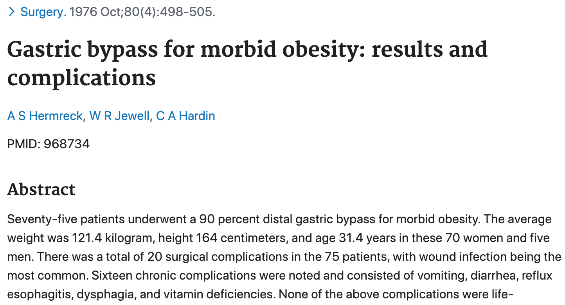

Slide 4
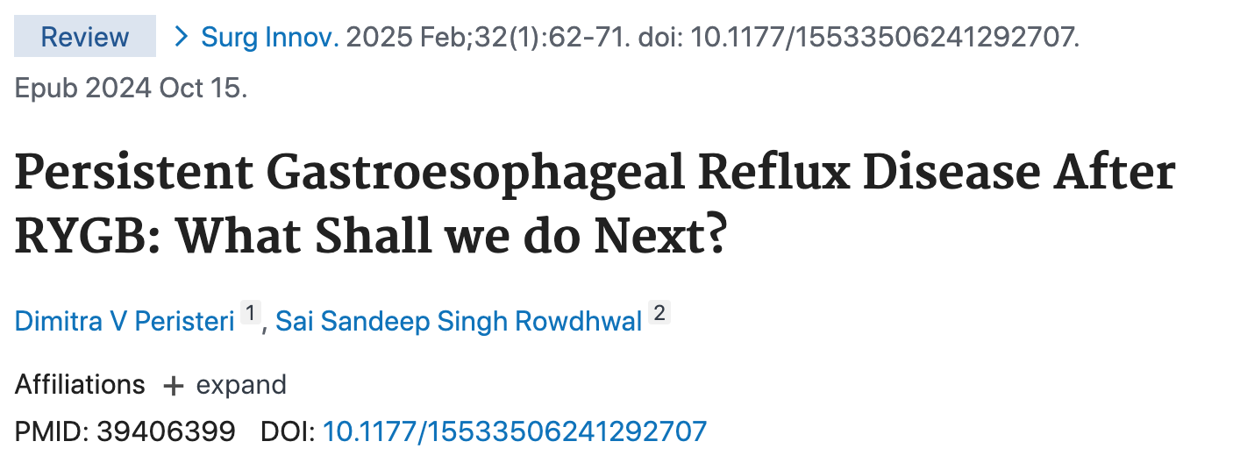

Slide 5

RYGB PRIMARIO O PER REVISIONE PER GERD. NON È PIÙ LA NOSTRA SOLUZIONE A TUTTO?
NO…

Slide 6
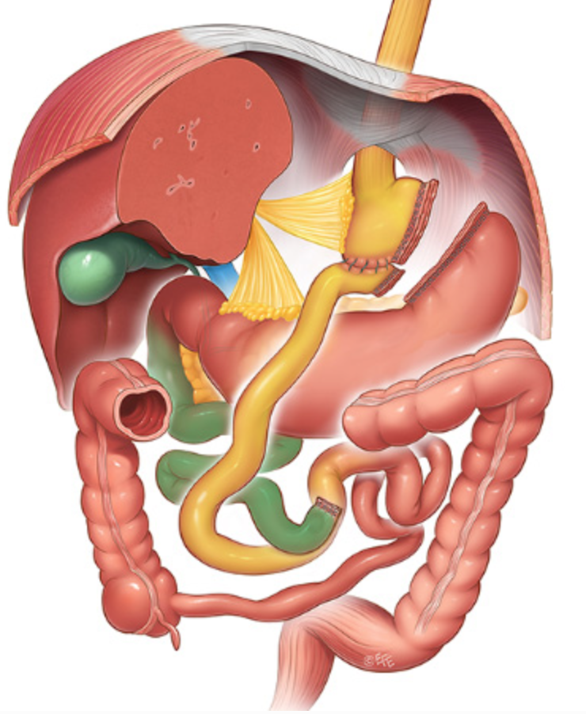

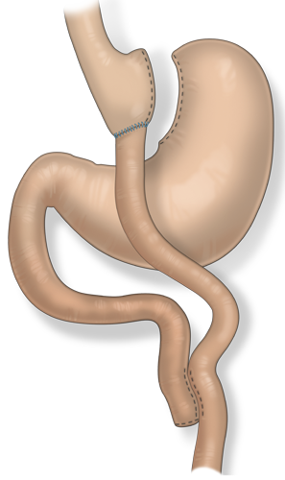
TUTTAVIA…
SMALL GASTRIC POUCH → MINIMAL ACID PRODUCTION
ABSENCE OF PYLORUS → NO LAPLACE EFFECT
ROUX LIMB → NO BILE REFLUX

Slide 7
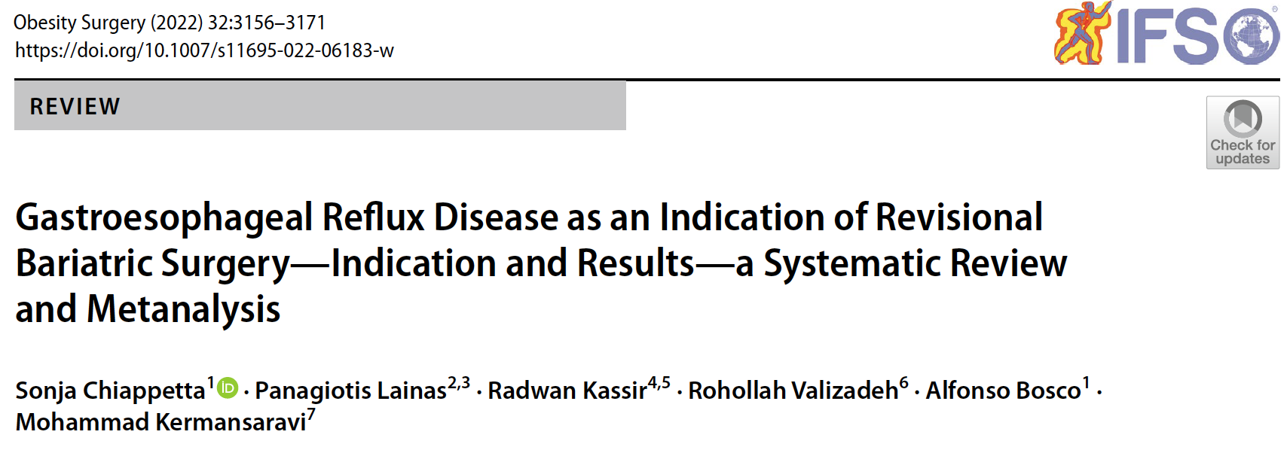
WHY ROUX-EN-Y? (1)

Slide 8
WHY ROUX-EN-Y? (2)
48 PAPERS, 17437 PATIENTS
915 PATIENTS TREATED WITH REVISIONAL BARIATRIC SURGERY (RBS)
PRIOR SURGERY: 87% SLEEVE, 6.8% OAGB
INDICATIONS: GERD 71.6%, GERD + WEIGHT ISSUES 16%, BILE REFLUX 6.2%
OVERALL 7% OF GERD AFTER PRIMARY SURGERY REQUIRING RBS
REVISIONAL SURGERY: 73.2% RYGB, RYGB + HHR, OAGB, RE-SG, SEROMYOTOMY
RESULTS: 99% REMISSION OF GERD

Slide 9
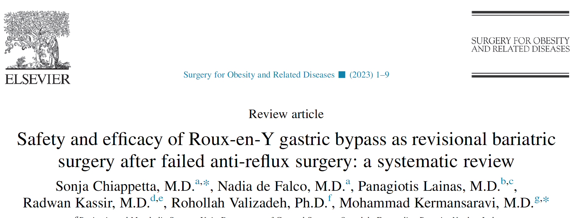
WHY ROUX-EN-Y? (3)
874 RYGB AFTER FAILED ANTIREFLUX SURGERY (NISSEN)
GERD IMPROVEMENT 92.6% (F-UP 25 MONTHS)

Slide 10
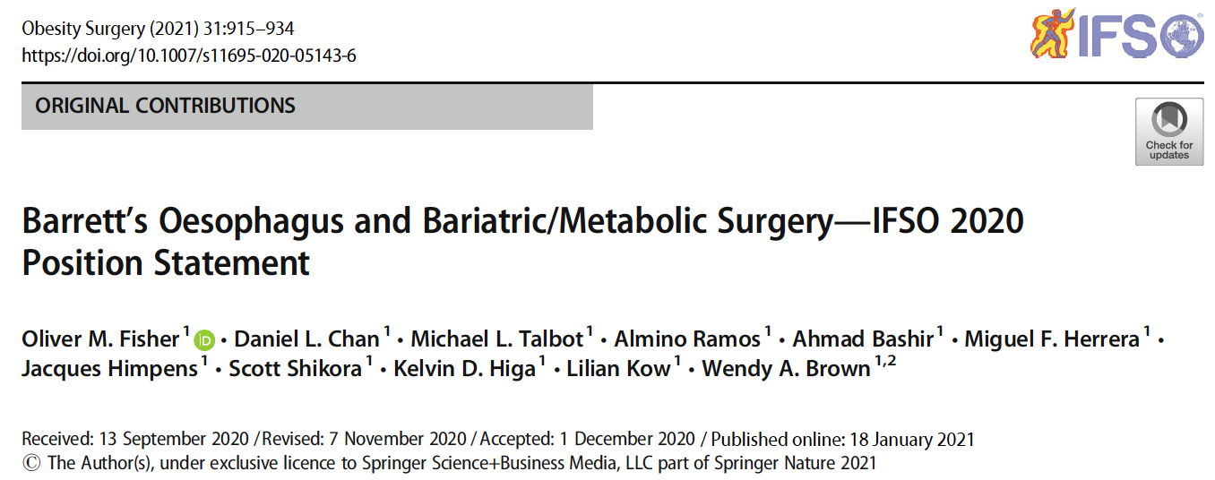
WHY ROUX-EN-Y? (4)
“RYGB IS THE PREFERRED PROCEDURE DUE TO EVIDENCE OF BE REGRESSION”

Slide 11
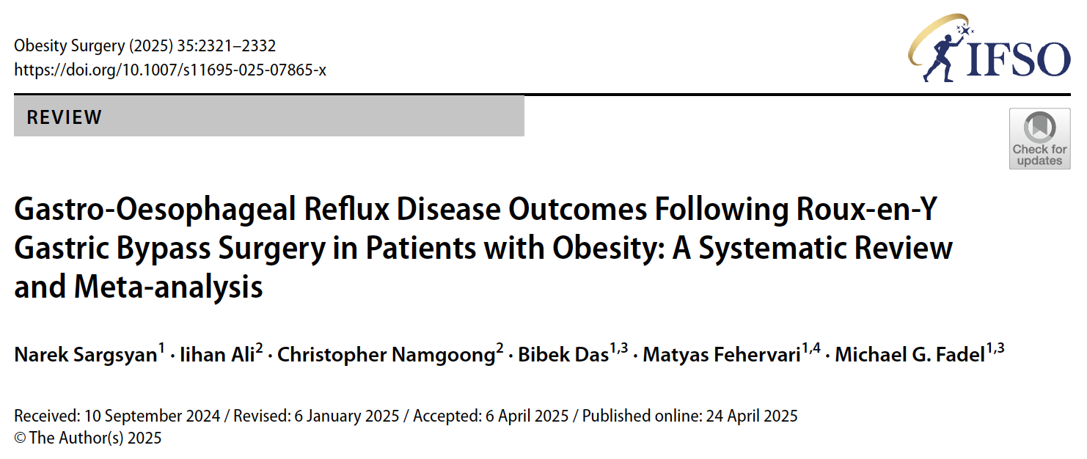
WHY ROUX-EN-Y? (5)

Slide 12
WHY ROUX-EN-Y? (6)
14 PAPERS, ONE RCT
28027 RYGB
79.4% STOP PPI, 47% REMISSION OF GERD,
4.5% DE NOVO GERD
ONLY 408 PATIENTS (1.45%!) STUDIED WITH PH-METRY/MANOMETRY
RYGB → GOOD OUTCOMES ON GERD, STRONG NEED OF RCTS ON GERD ASSESSMENT

Slide 13
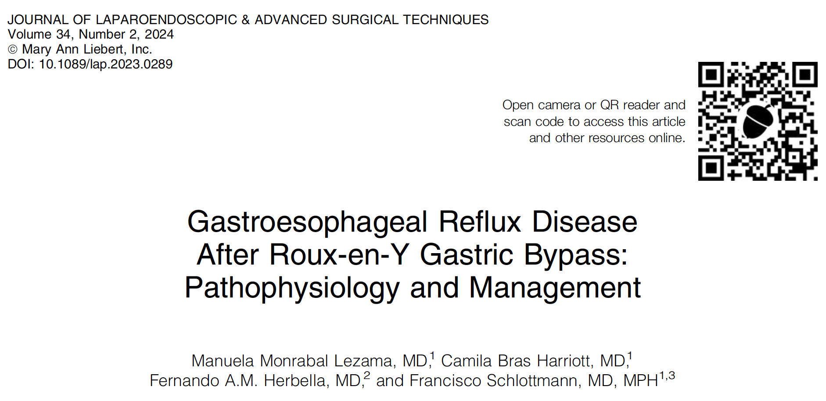
WHY GERD AFTER ROUX-EN-Y? (1)

Slide 14
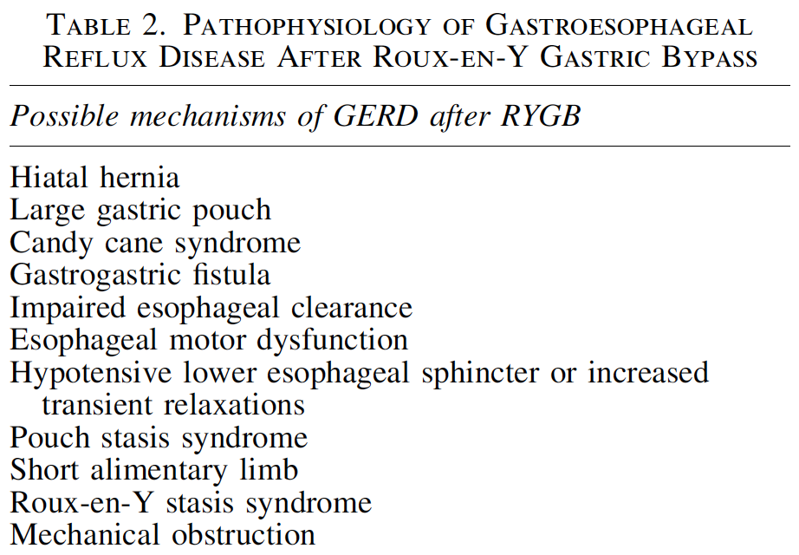
WHY GERD AFTER ROUX-EN-Y? (2)

Slide 15
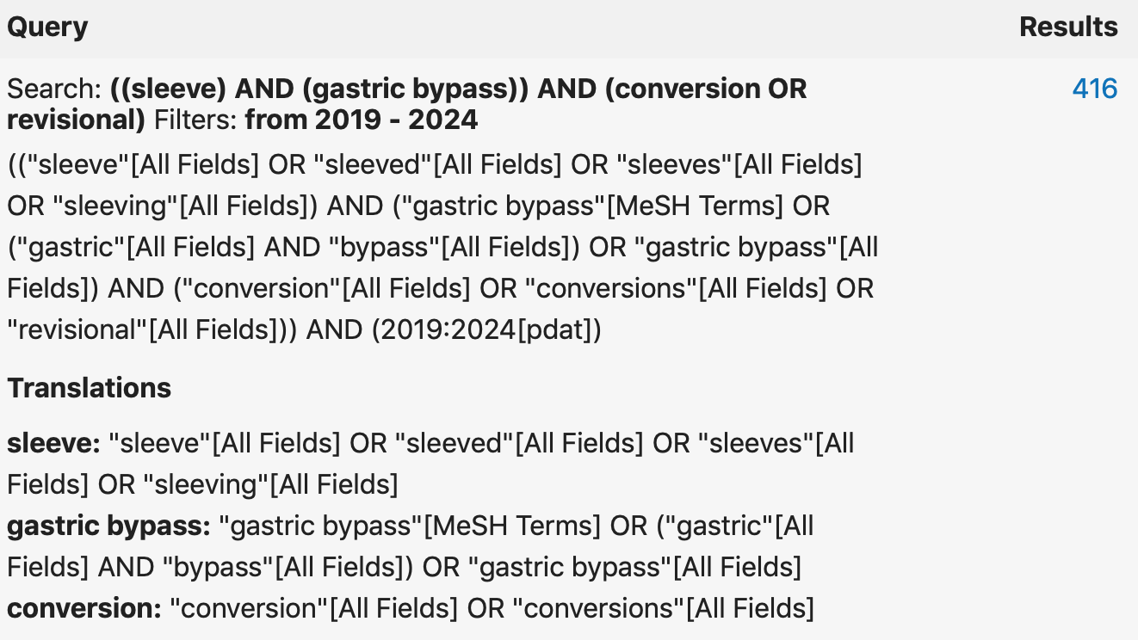
WHY GERD AFTER ROUX-EN-Y? (3)

Slide 16
WHY GERD AFTER ROUX-EN-Y? (4)
16 PAPERS
18060 R-RYGB AFTER SG FOR GERD
433 R-RYGB AFTER SG FOR GERD WITH MEAN F-UP 26.7 ± 16.18 MONTHS (13 PAPERS) FOCUSED ON GERD OUTCOME
17627 R-RYGB AFTER SG FOR GERD WITH 30 DAYS F-UP (MBSAQIP Registry) FOCUSED ON COMPLICATIONS (3 PAPERS)

Slide 17
WHY GERD AFTER ROUX-EN-Y? (5)
TYPE OF ASSESSMENT OF GERD BEFORE REVISION (AFTER SG):
SYMPTOMS (+ PPI USAGE): 100%
ENDOSCOPY: 75.3% (WIDE ETEROGENITY 0-100%)
UGI SERIES: 40.4% (WIDE ETEROGENITY 0-100%)
pH-METRY: 8.5%
MANOMETRY: 17.1%
TYPE OF ASSESSMENT OF GERD AFTER REVISION (AFTER R-RYGB):
NOT REPORTED IN 23% STUDIES (3/13)
SYMPTOMS (+ PPI USAGE): 100%
ENDOSCOPY: 32.9%
UGI SERIES: 6%
pH-METRY: 11.2%
MANOMETRY: 12.1%

Slide 18

CONCLUSIONS
RYGB STILL THE MOST PERFORMED MB PROCEDURE FOR OBESITY + GERD, UP TO 80%
PRIMARY AND REVISION
GOOD RESULTS IN TERMS OF GERD RESOLUTION (UP TO >90%)
GERD AFTER RYGB → LOW RATE, BUT FOREVER AND ALWAYS!!!
STRONG NEED OF GERD ASSESSMENT PROTOCOLS BEFORE AND AFTER RYGB
ROLE OF NEW PERSPECTIVES/TECHNIQUES

Slide 19
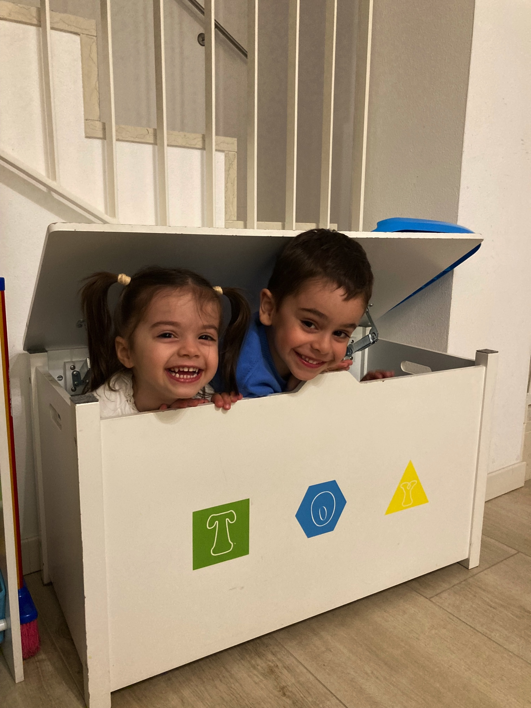
GRAZIE!
DR. GIACOMO PIATTO
U.O. CHIRURGIA GENERALE
OSPEDALE DI CITTADELLA (PD)
giacomoplatz@gmail.com

